Slide 1
Data Analysis Project on Electric
Vehicles Sales in SQL
By
Subrato Samaddar

Slide 2
Table Name: electric_vehicles
Total number of rows: 1,86,879
This dataset contains detailed information about electric vehicles registered in a certain region.
Each record represents an individual electric vehicle and includes various attributes such as location, vehicle specifications, and utility details.
The dataset can be used to analyze trends in electric vehicle adoption, geographic distribution, and the characteristics of different electric vehicle models.

Slide 3
Columns Description:
► VIN (Vehicle Identification Number): A unique identifier for each vehicle, typically composed of 17 characters, but this dataset seems to be using the first 10 characters.
County: The county in which the vehicle is registered.
City: The city in which the vehicle is registered.
State: The state in which the vehicle is registered.
Postal Code: The postal code for the vehicle's registration address. Model Year: The year the vehicle model was manufactured. Make: The manufacturer or brand of the vehicle (e.g., Tesla, Nissan).
Model: The specific model name or number of the vehicle.
Electric Vehicle Type: The type of electric vehicle (e.g., Battery Electric Vehicle (BEV), Plug-in Hybrid Electric Vehicle (PHEV)).
► Clean Alternative Fuel Vehicle (CAFV) Eligibility: Indicates whether the vehicle is eligible for clean alternative fuel vehicle incentives.

Slide 4
• Objective: To analyze electric vehicle sales data and derive meaningful insights using SQL.
• Scope:
Data Extraction and Transformation
Sales Trends and Growth Analysis
Top Models and Manufacturers
Range Analysis
• Tools Used: SQL

Slide 5
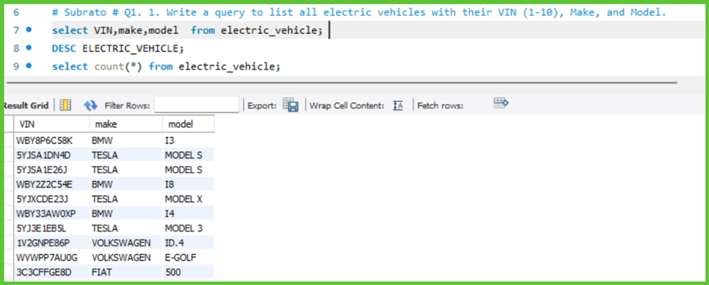

Slide 6
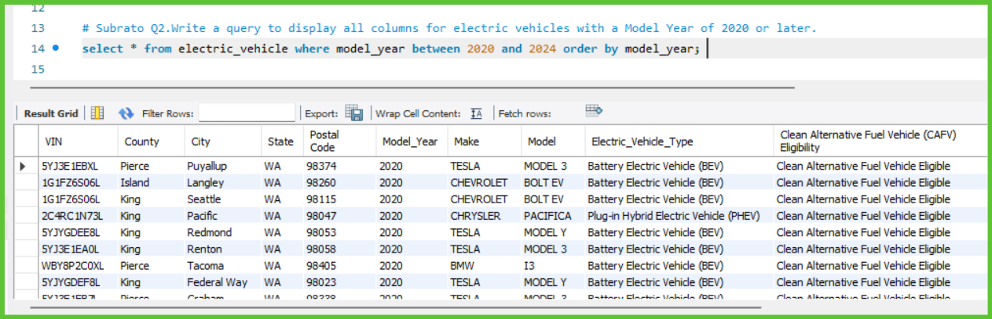

Slide 7
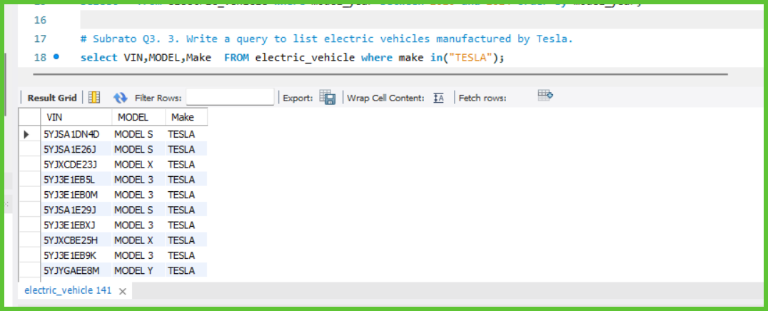

Slide 8
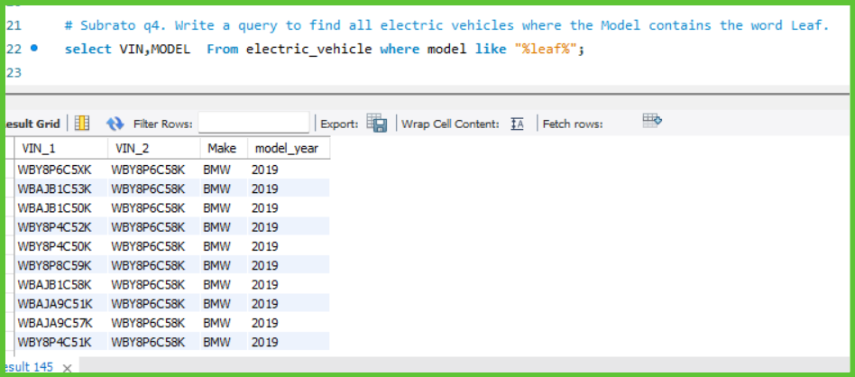

Slide 9
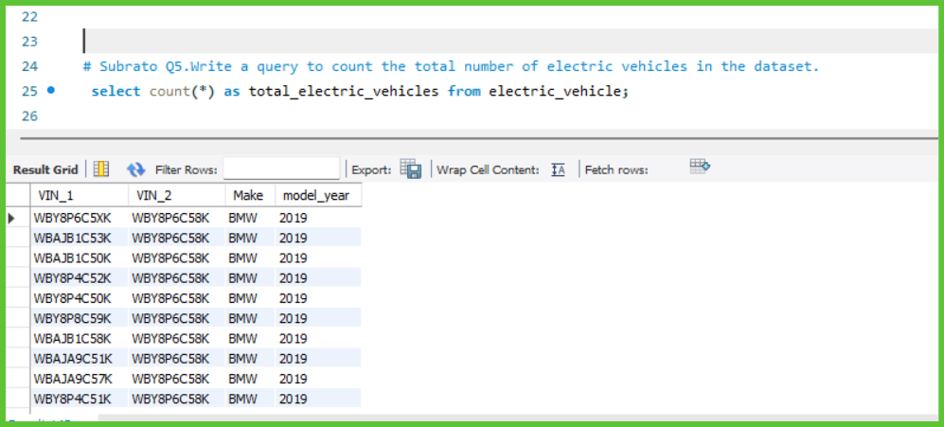

Slide 10
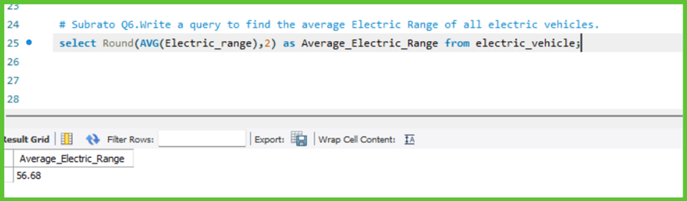

Slide 11
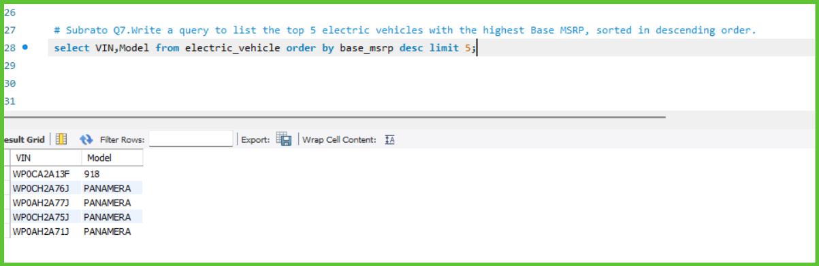

Slide 12
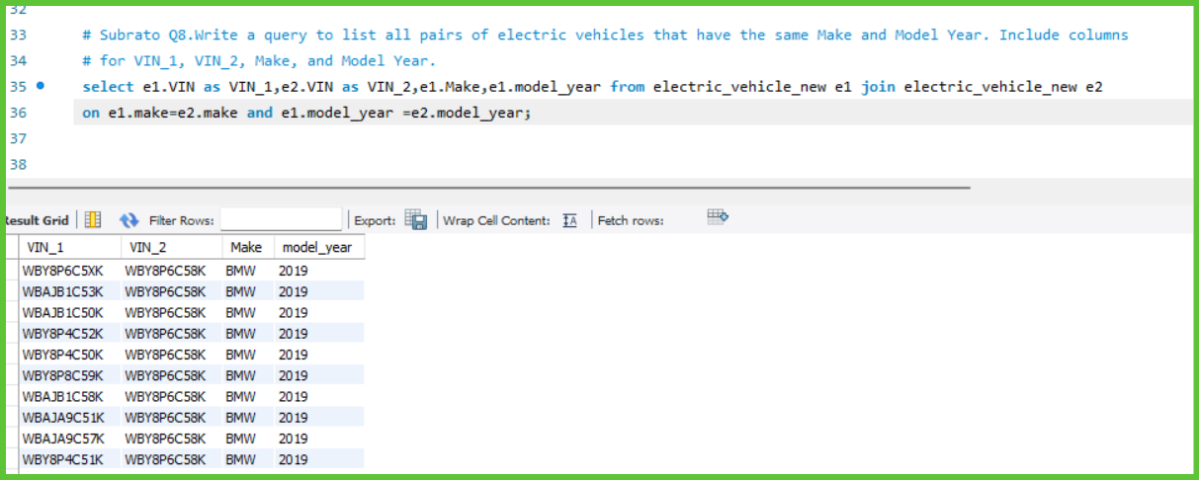

Slide 13
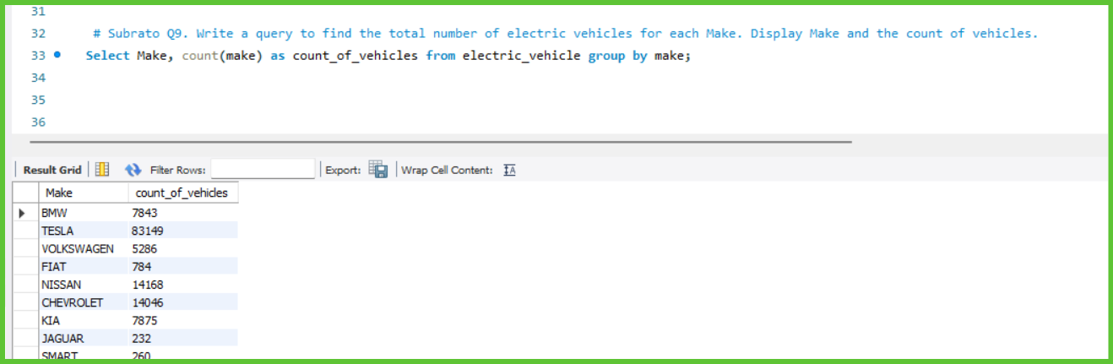

Slide 14
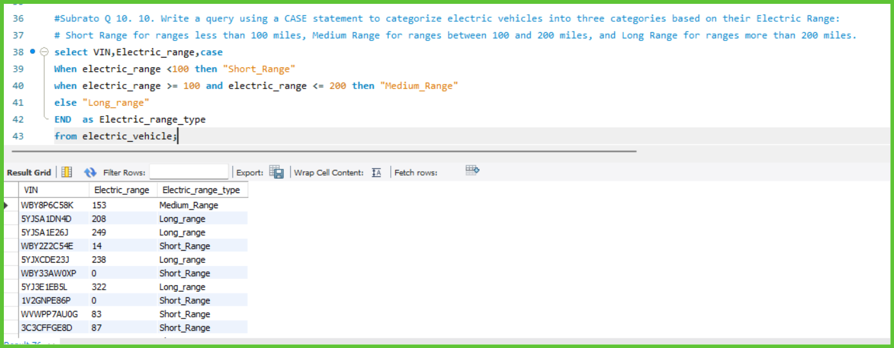

Slide 15
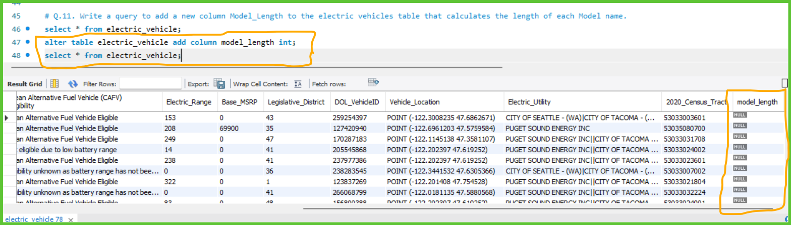

Slide 16
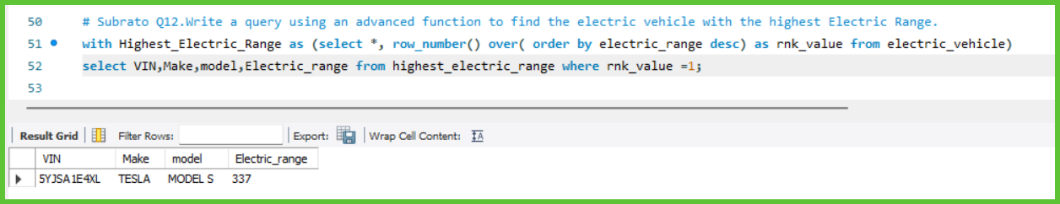

Slide 17
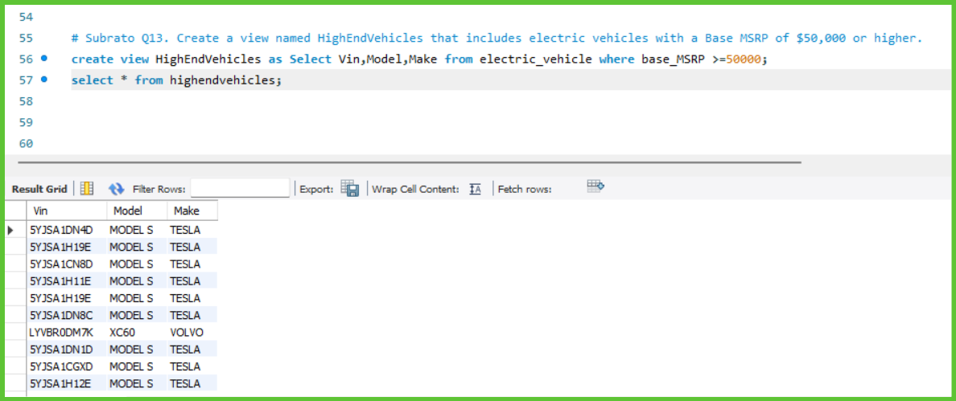

Slide 18
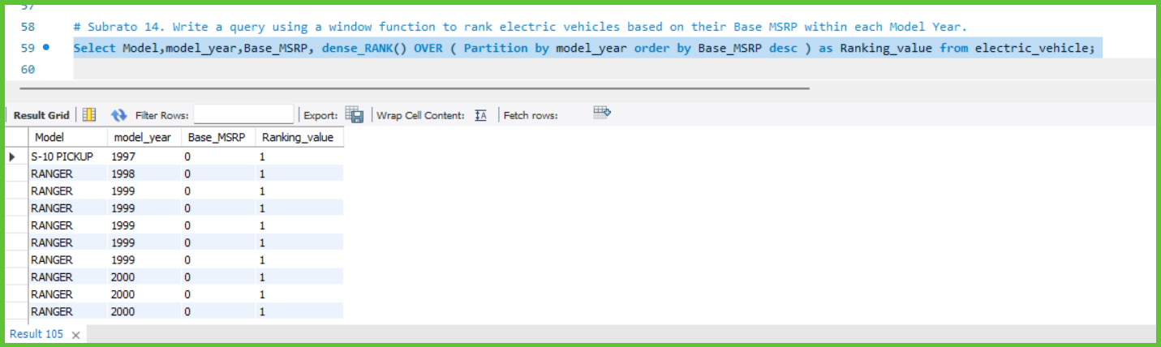

Slide 19
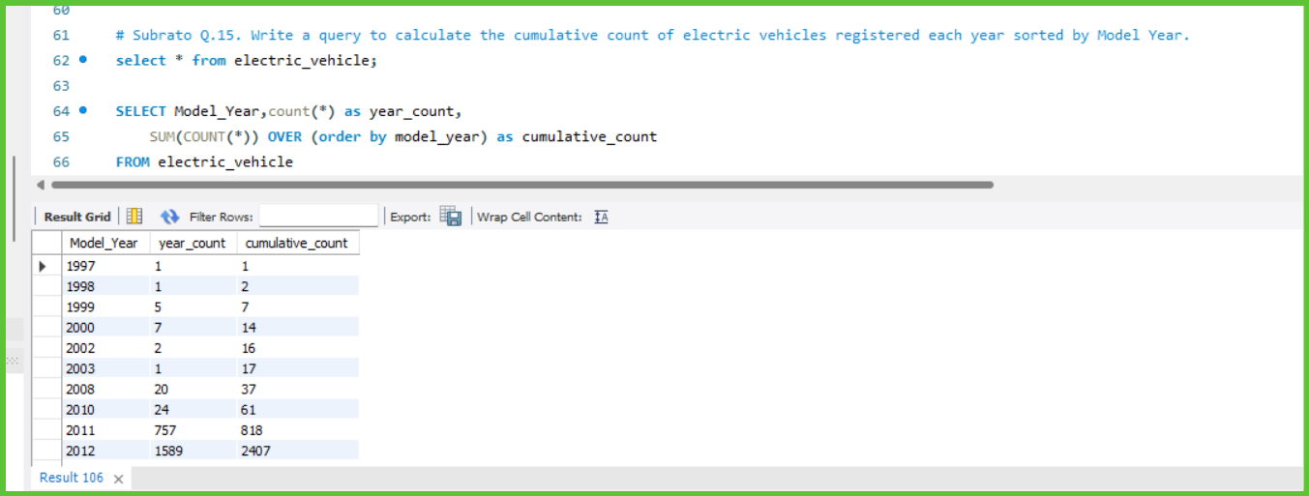

Slide 20
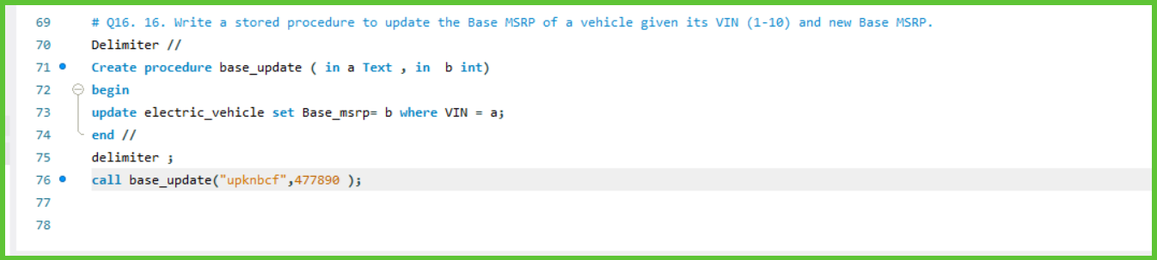

Slide 21
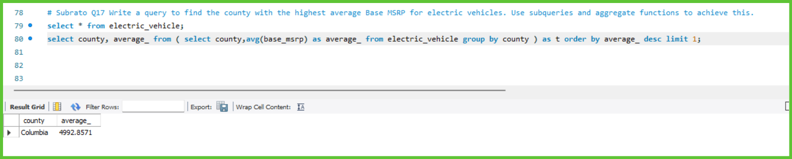

Slide 22
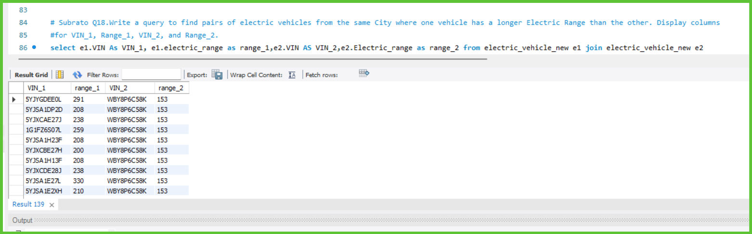

Slide 23
Conclusion and Future Work
• Key Insights:
• Significant growth in electric vehicle registrations over recent years.
• Top models and manufacturers driving the market.
Highest electric ranges achieved by leading models.

Slide 24
• Next Steps:
• Incorporate more detailed demographic data for deeper insights.
• Explore predictive analytics for future sales trends.
Enhance data visualization for more interactive analysis

Slide 25
Thank You

